Slide 1
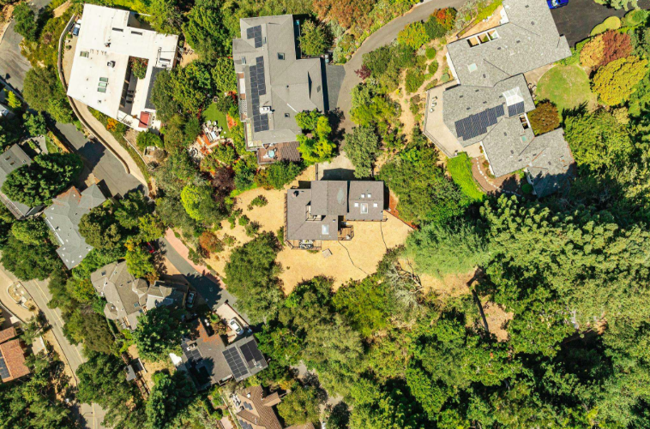


Slide 2
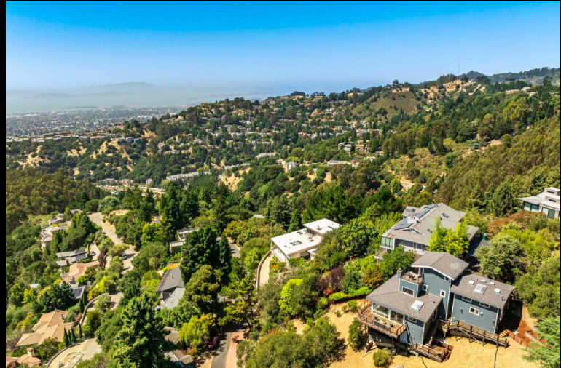

Slide 3
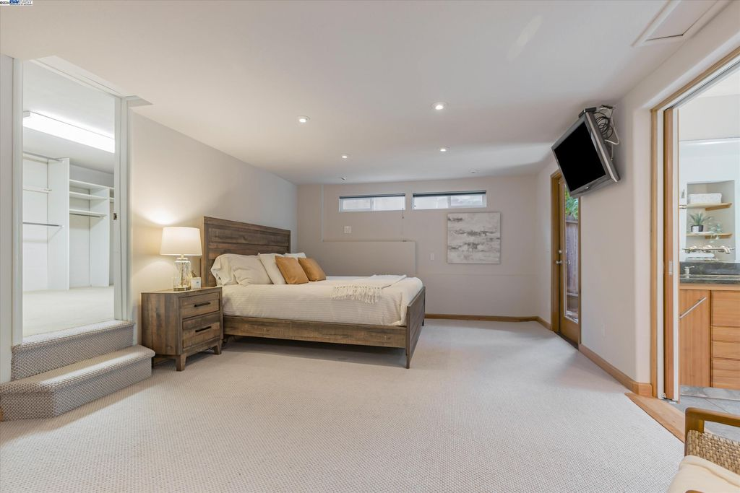
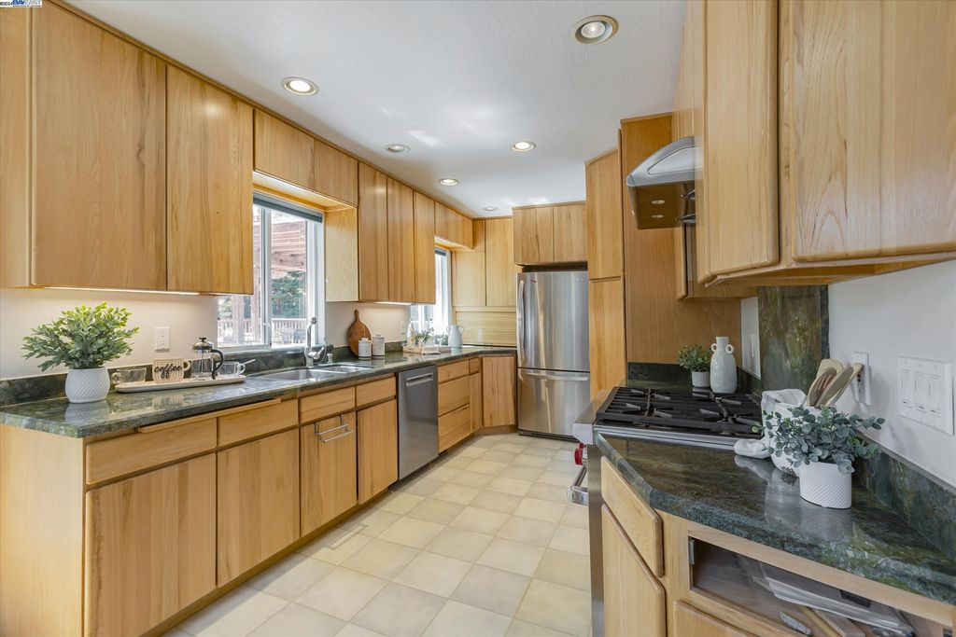
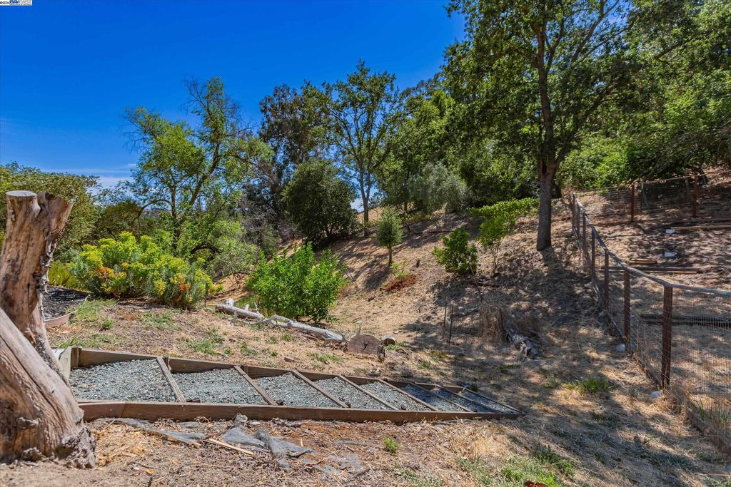
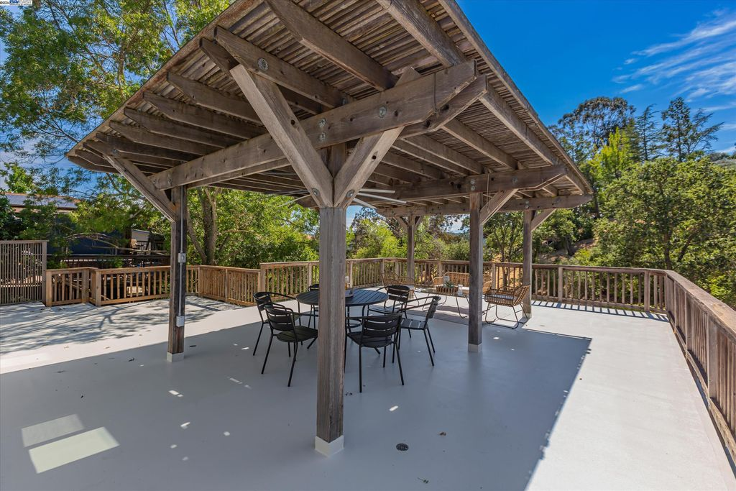
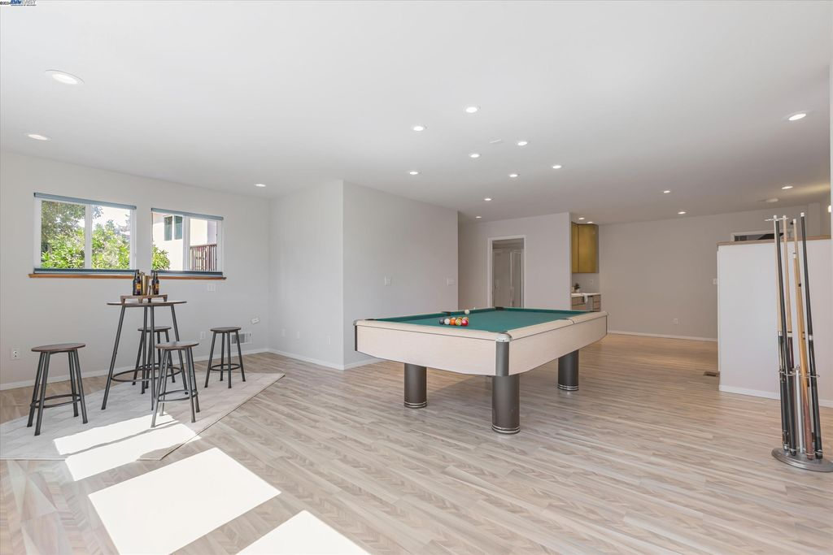
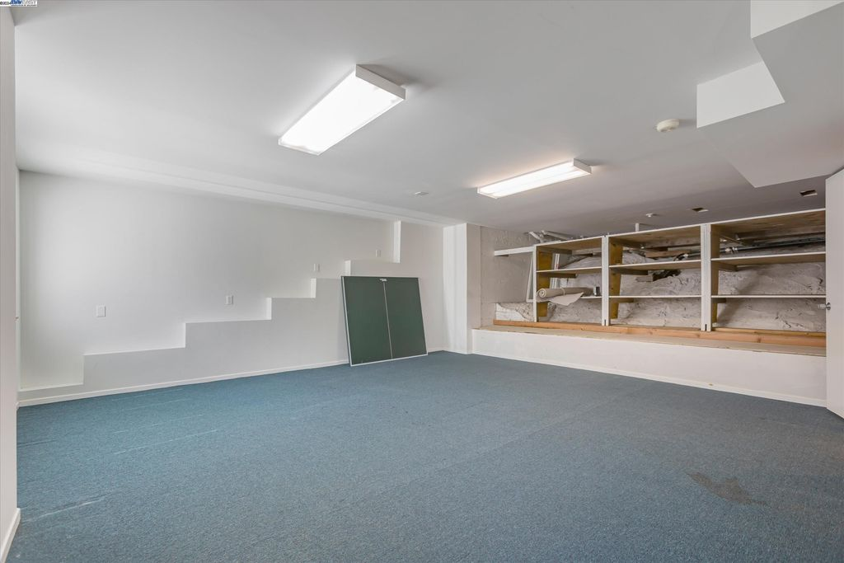
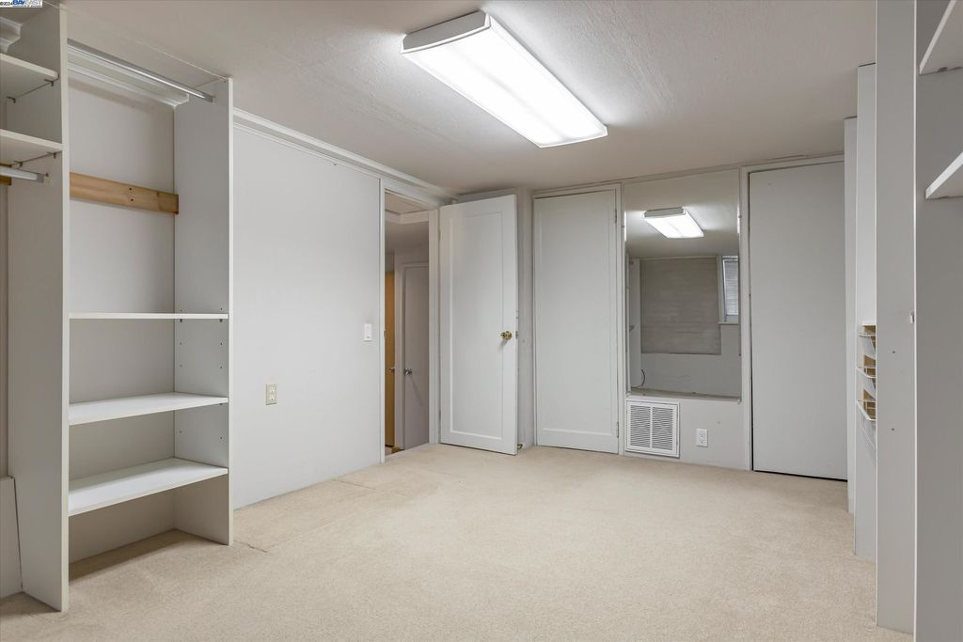
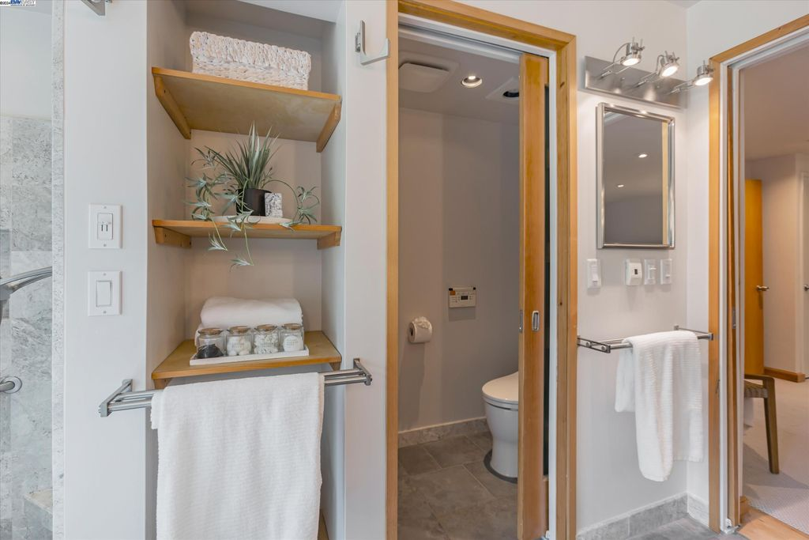
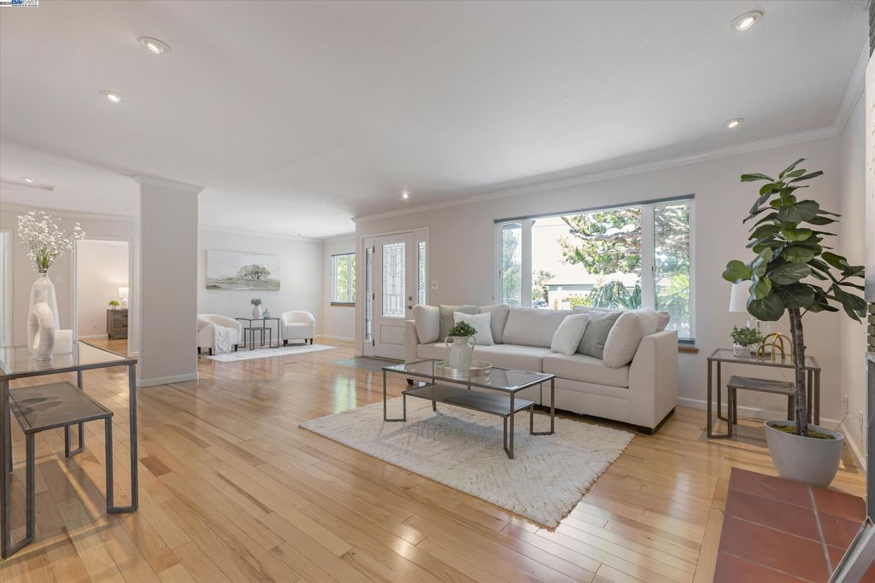
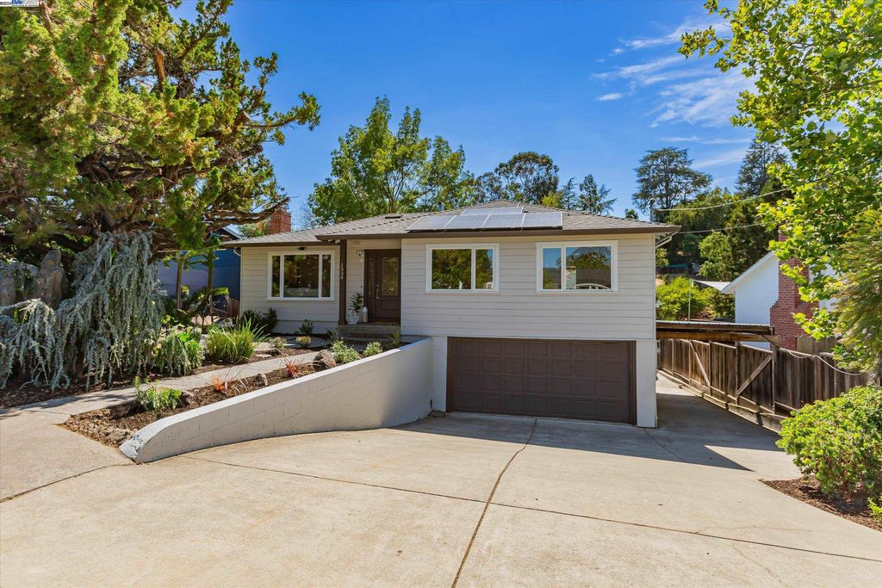
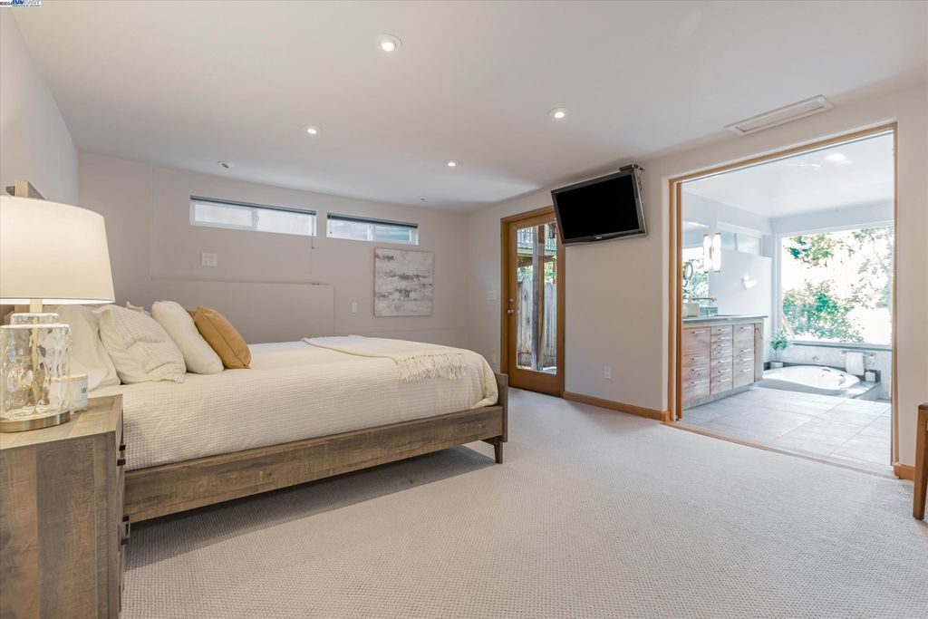
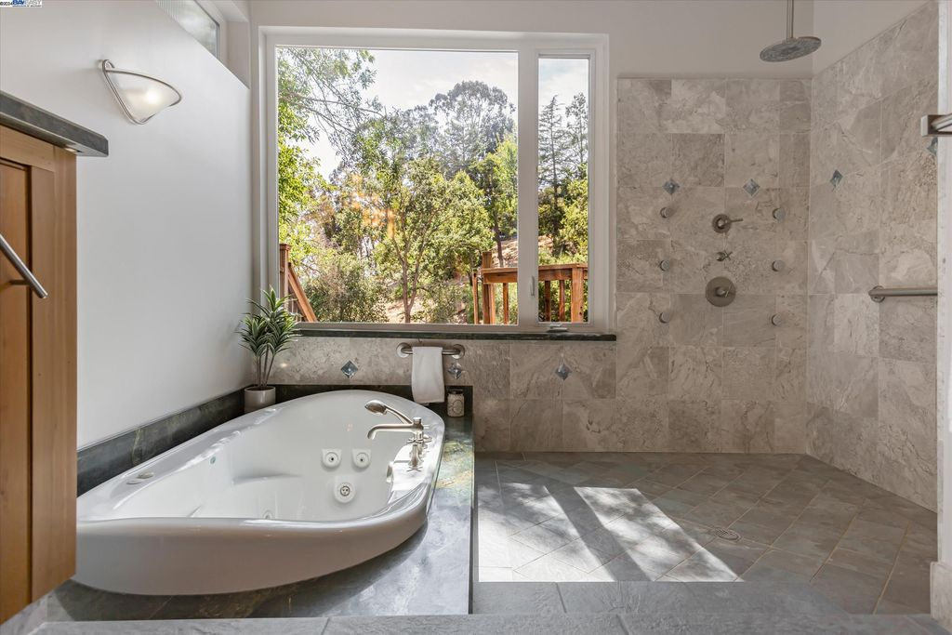
This is truly turn key (add small pool/hot tub)
Tons of Room for expansion inside and out
Large Covered outdoor entertainment for an Italian family
Master is ground floor surrounded by thermal mass with a HUGE walk in closet!
Parking for 10-12 cars
Massive Master Walk-in Closet
Walk in shower so large you don’t need a door
Thermal Mass & solar/batteries for offgrid..The entire basement is below frost line making it super cheap, if not free, to keep master cool and warm!
Ground floor outside access
No Linoleum, Counters are Granite, Mostly wood, tile and high end carpets

Slide 4







Slide 5








Scrap
Screen Scraper

