Slide 1
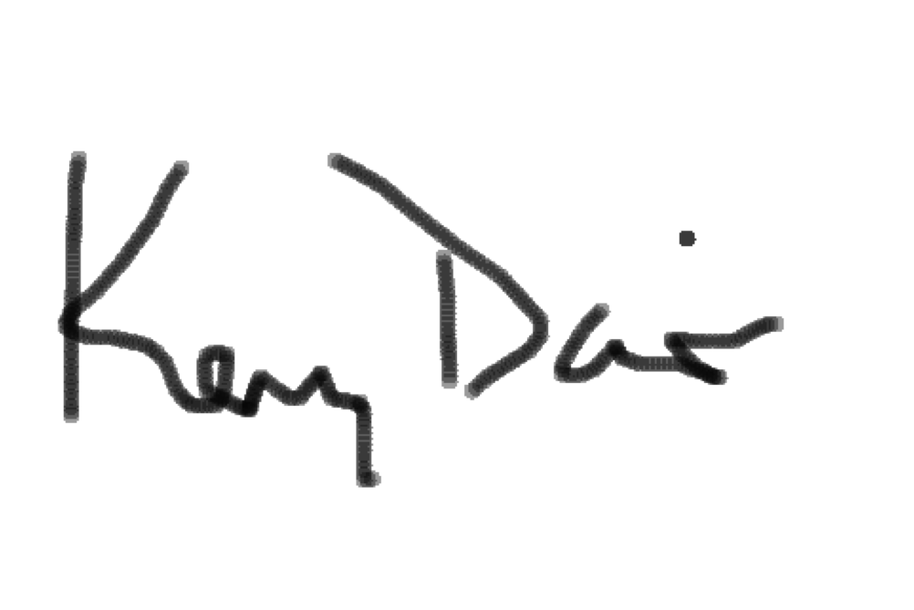
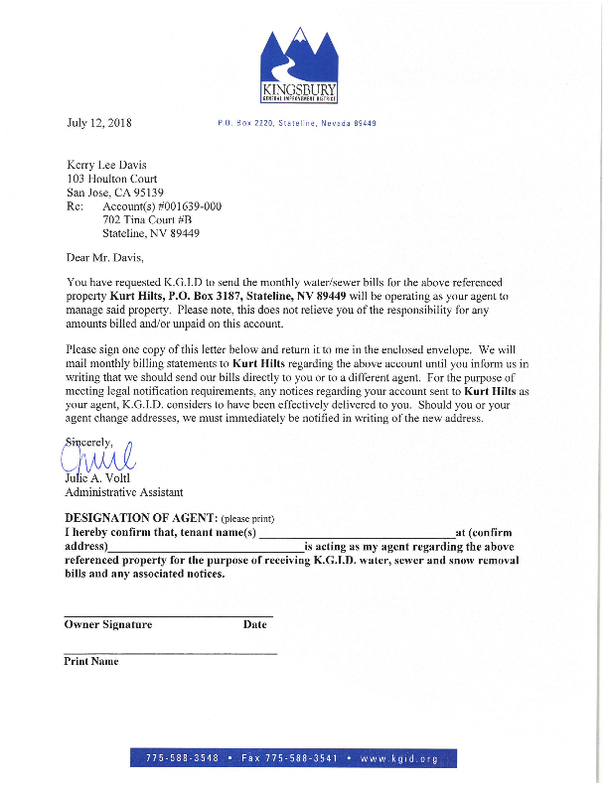
Kurt Hilts
702 Tina Ct #B, Stateline NV 89449
July 12, 2018
Kerry Davis

